Slide 1
Jewish Art
The Impact of Judaism on Art and Photography
Notes:
Presentation for Jewish Art

Slide 2
A Cornucopia of Artists
Diane Arbus
Amadeo Modigliani
Louise Nevelson
Richard Avedon
Marc Chagall
Camille Pissarro
Alfred Eisenstaedt
Judy Chicago
Man Ray
Ben Shahn
Frida Kahlo
Art Spiegelman
Alfred Stieglitz
Roman Vishniac
Annie Leibovitz
Roy Lichtenstein
Max Liebermann
Jacques Lipschitz

Slide 3
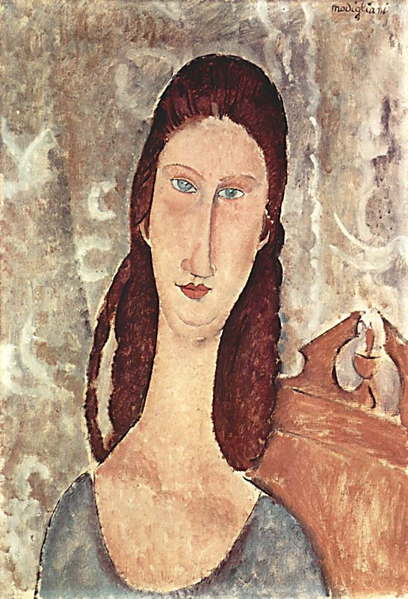
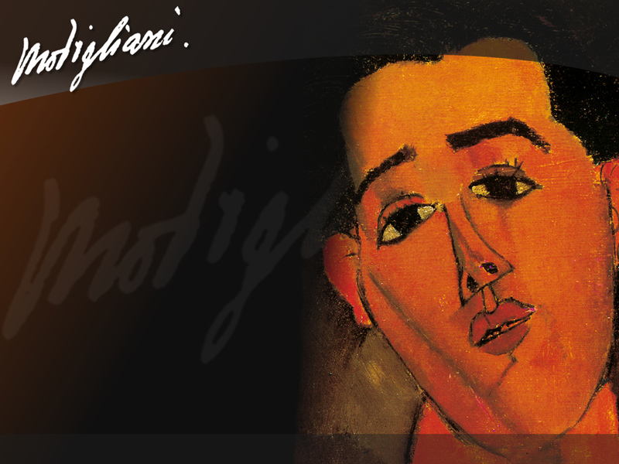
Early Modern Painters
Amadeo Modigliani
Notes:
"I want to be a tuneswept fiddle string that feels the master melody, and snaps..."
Amedeo Modigliani, a painter and a sculptor, was born July 2, 1884, in Livorno, Italy. Modigliani came from a wealthy background. His family were Sephardic Jews, and when his father's career was ruined as a banker, he was forced to work as a wood and coal merchant. Sadly, Amedeo lost his father while still a young boy.
Modigliani's health was very delicate, as he had very weak lungs, which he had inherited from his family. He had many close calls with pneumonia while he was growing up and spent many years being cared for by his worried mother and sisters. He developed tuberculosis and battled with it for the rest of his life. His mother had been the first one to notice and encourage his incredible talent and she sent him to study at art academies in Florence and Venice. Finally, in 1902, when he was 17yrs, he left for Venice, excited about beginning his art studies.
Five years later in 1907, he arrived in Paris, ready for fame and fortune, but within weeks he found himself penniless, and had to move from one seedy hotel to another. He was getting out 'n' about however, and meeting all the famous writers and artists of the day from Picasso to Utrillo. According to a good friend of his, he looked very dashing in his brown corduroy coat that he wore everywhere, the bright scarf around his neck, and his broad felt hat. He was very handsome, brooding and thought of as eccentric by his close friends. Modigliani did crazy things in Paris, like dancing in the moonlight with a famous prostitute and getting jailed for drunkenness constantly. He was very successful at attracting women, who found him quite irresistable, and he could always find willing models to paint. Modigliani was involved in one love affair after another, and was completely swallowed up by the dark side of the Parisian nightlife. Women quite fascinated him, and he once said, "Women of beauty worth painting or sculpting, often seem encumbered by their clothes".
In 1909, he found himself in a sticky patch. He really needed money, and he had to keep moving from one tiny studio to another, to escape angry landlords. He was even reduced at one time, to pushing his belongings in a wheelbarrow through the streets. He wasn't taking care of himself and was always coming down with infections. Finally, he had to return to his home in Italy that summer, to recover and regain his strength. He returned to Paris and then in 1913, his health worsened. His lungs were giving him a lot of trouble, and each time he got sick, he would go home to recover. He was constantly drinking and using drugs and was thoroughly miserable. He was wasting his talents as much as he wasted his money. He could never make enough money to live and was used to selling his drawings for only a few sous. He drifted from cafe to cafe and attic to attic.
He made friends with the sculptor Brancusi, who introduced him to African sculpture. Modigliani was utterly fascinated with the simplicity of African masks and art and kept it all in mind when he painted his portraits. He never really mastered the medium of sculpture and left many pieces unfinished, but from this time on, his paintings were far more influenced by what he had learnt through sculpture.
At Zborowski's home, a Polish friend and poet, Modigliani met his beloved, Jeanne Hebuterne, who was also a very talented young artist. Amedeo was over the moon with Jeanne and they fell deeply in love, married and soon had a son.
With Zborowski's encouragement, Modigliani agreed to opening an art show on Oct 3rd, 1917. This was to be his first show and he didn't know what to expect. He had gathered together a total of 32 paintings and drawings. Almost nothing sold, except for some drawings. His show was actually closed for 'indecency' the same day it opened. In desperate financial trouble and very ill, his good friend, Zborowski, paid for the couple to go to Nice for the winter.
In 1918, Jeanne gave birth to a daughter. Amedeo was overjoyed, but he soon had to begin moving his little family around from hotel to hotel. Amedeo was terribly ashamed at not having enough money to support his family. Jeanne even left their little daughter with her wet nurse, and began to paint once more, using her husband as her model.
Modigliani became weaker and weaker, yet still he continued to paint the people around them. He was a remarkable painter, and it shows through his compelling portraits. He often deliberately chose sickly children to paint, feeling a connection with them and their sickness. He had a love of the humble people, which he expressed in his drawings, his paintings and his choice of models. He would often be seen on the terraces, drawing portraits and then offering them to his subjects, in the hope of getting a drink in return.
In the middle of January, his friends found him as he lay dying in his studio, next to his distraught wife. They took him to a hospital, where he later died of tubercular meningitis, combined with the affects of too much alcohol and drugs. Amedeo Modigliani died while just 36yrs, January 25th, 1920. The next day, his hysterical wife threw herself from a window of her parent's home. Jeanne was 9 months pregnant and carrying their third child at the time. Sadly, both Jeanne and her unborn child died instantly.
Modigliani was an artist whose paintings are dominated by his sense of linear design. He used line exclusively to suggest body and form, with skill and sensitivity. He used distortion as a way of highlighting characteristics of his subjects, and perhaps, maybe even their personalities? Modigliani developed his own unique style, surrounded by artists experimenting with impressionism, surrealism, and cubism. Many of his subject's heads are elegantly bowed with swan-like necks, and sloping shoulders. The effect is delicate and gentle, yet you feel the people in these paintings are almost aloof, in a dreamy kind of way. His faces are very distinctive with the long thin noses, the empty almond-shaped eyes, and the tiny pursed lips. The eyes are so haunting and when I look at them, it seems odd that they look quite normal in his paintings, as if everyone has empty eyes. Some people feel he played on the sickness in humanity, while others (myself included), recognize it as a new definition in breathtaking beauty.
Source: "Amedeo Modigliani." A dozen lilacs in a shoebox.

Slide 4
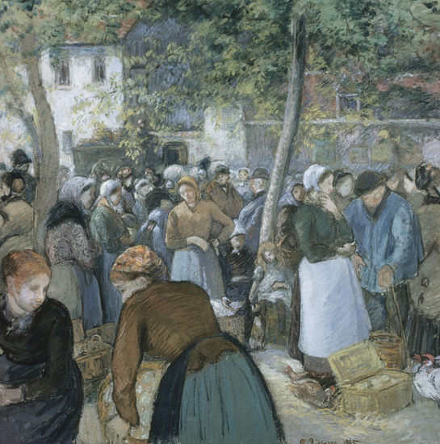
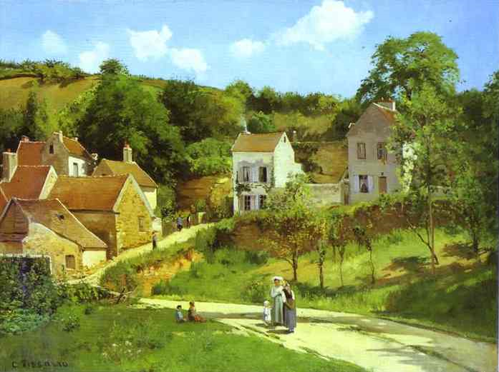
Early Modern Painters
Camille Pissarro
Notes:
Camille Pissarro (10 July 1830 – 13 November 1903) was a Danish Impressionist and Neo-Impressionist painter born in the Virgin Islands, where his father was of Portuguese Jewish descent and his mother was native Creole.^{[1]} He studied in Paris and London, becoming a permanent resident of France. His importance resides in his contributions to both Impressionism and Post-Impressionism, as he was the only artist to exhibit in both forms. Pissarro studied from great forerunners, including Courbet and Corot. He later studied and worked alongside Georges Seurat and Paul Signac when he took on the Neo-Impressionist style at the age of 54.
In 1873 he helped establish a collective society of fifteen aspiring artists, becoming the “pivotal” figure in holding the group together and encouraging the other members. Impressionism historian John Rewald called Pissarro the “dean of the Impressionist painters", not only because he was the oldest of the group, but also "by virtue of his wisdom and his balanced, kind, and warmhearted personality”.^{[2]} Cézanne said "he was a father for me. A man to consult and a little like the good Lord," and he was also one of Gauguin's masters. Renoir referred to his work as “revolutionary”, through his artistic portrayals of the "common man", as Pissarro insisted on painting individuals in natural settings without "artifice or grandeur".
Pissarro is the only artist to have shown his work at all eight Paris Impressionist exhibitions, from 1874 to 1886. As a stylistic forerunner of Impressionism, he is today considered a "father figure not only to the Impressionists" but to all four of the major Post-Impressionists, including Paul Cézanne, Vincent van Gogh and Paul Gauguin.^{[1]}

Slide 5
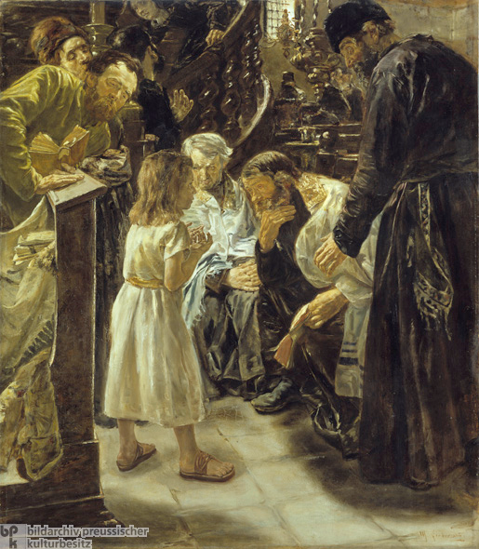
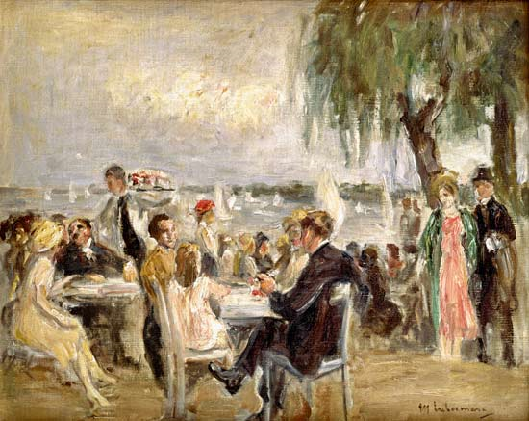
Early Modern Painters
Max Liebermann
Notes:
Max Liebermann (July 20, 1847 – February 8, 1935) was a German-Jewish painter and printmaker best known for his etching and lithography.^{[1]}
"Ins Schwimmbad," late 1870's, Dallas Museum of Art
The son of a Jewish businessman from Berlin, Liebermann first studied law and philosophy at the University of Berlin, but later studied painting and drawing in Weimar in 1869, in Paris in 1872, and in the Netherlands in 1876–77. During the Franco-Prussian War (1870–71), Liebermann served as a medic with the Order of St. John near Metz. After living and working for some time in Munich, he finally returned to Berlin in 1884, where he remained for the rest of his life. He was married in 1884 to Martha Liebermann (1857–1943, see portrait by Anders Zorn).
He used his own inherited wealth to assemble an impressive collection of French Impressionist works. He later chose scenes of the bourgeoisie, as well as aspects of his garden near Lake Wannsee, as motifs for his paintings. In Berlin, he became a famous painter of portraits; his work is especially close in spirit to Édouard Manet. From 1899 to 1911 he led the premier avant-garde formation in Germany, the Berlin Secession. Beginning in 1920 he was president of the Prussian Academy of Arts. In 1933 he resigned when the academy decided to no longer exhibit works by Jewish artists. While watching the Nazis celebrate their victory by marching through the Brandenburg Gate, Liebermann was reported to have commented: "Ich kann gar nicht so viel fressen, wie ich kotzen möchte" ("I cannot eat as much as I would like to vomit").
Together with Lovis Corinth and Max Slevogt, Liebermann became an exponent of German Impressionism.
[edit] Commemoration
Martha Liebermann by Anders Zorn
Liebermann's grave in Berlin
On April 30, 2006, the Max Liebermann Society opened a permanent museum in the Liebermann family's villa in the Wannsee district of Berlin.^{[2]} The artist's wife, Martha Liebermann, was forced to sell the villa in 1940. On March 5, 1943, at the age of 85 and bedridden from a stroke, she was notified to get ready for deportation to Theresienstadt concentration camp.^{[3]} Instead, she committed suicide in the family home, Haus Liebermann, hours before police arrived to take her away. There is a stolperstein for her in front of their former home by the Brandenburg Gate in Berlin.^{[3]}

Slide 6
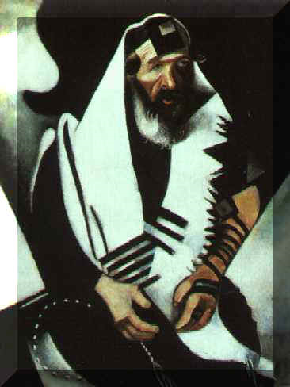
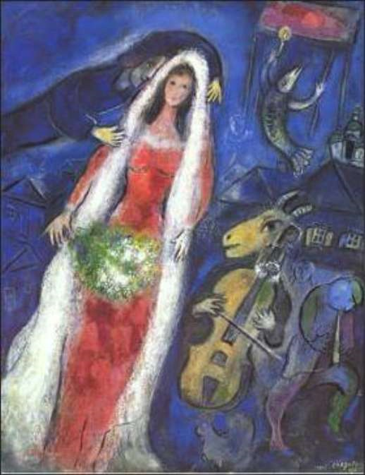
Modern Painters
Marc Chagall
Notes:
Marc Chagall was born in Vitebsk, Byelorussia to a poor Hassidic family. The eldest of nine children, he studied first in a heder before moving to a secular Russian school, where he began to display his artistic talent. With his mother's support, and despite his father's disapproval, Chagall pursued his interest in art, going to St. Petersburg in 1907 to study art with Leon Bakst. Influenced by contemporary Russian painting, Chagall's distinctive, child-like style, often centering on images from his childhood, began to emerge.
From 1910 to 1914, Chagall lived in Paris, and there absorbed the works of the leading cubist, surrealist, and fauvist painters. It was during this period that Chagall painted some of his most famous paintings of the Jewish shtetl or village, and developed the features that became recognizable trademarks of his art. Strong and often bright colors portray the world with a dreamlike, non-realistic simplicity, and the fusion of fantasy, religion, and nostalgia infuses his work with a joyous quality. Animals, workmen, lovers, and musicians populate his figures; the “fiddler on the roof” recurs frequently, often hovering within another scene. Chagall's work of this period displays the influence of contemporary French painting, but his style remains independent of any one school of art. He exhibited regularly in the Salon des Independants.
In 1914, before the outbreak of World War I, Chagall held a one-man show in Berlin, exhibiting work dominated by Jewish images and personages. During the war, he resided in Russia, and in 1917, endorsing the revolution, he was appointed Commissar for Fine Arts in Vitebsk and then director of the newly established Free Academy of Art. The Bolshevik authorities, however, frowned upon Chagall's style of art as too modern, and in 1922, Chagall left Russia, settling in France one year later. He lived there permanently except for the years 1941—1948 when, fleeing France during World War II, he resided in the United States. Chagall's horror over the Nazi rise to power is expressed in works depicting Jewish martyrs and Jewish refugees.
In addition to images of the Hassidic world, Chagall's paintings are inspired by themes from the Bible. His fascination with the Bible culminated in a series of over 100 etchings illustrating the Bible, many of which incorporate elements from Jewish folklore and from religious life in Vitebsk. Chagall's other illustrations include works by Gogol, La Fontaine, Y. L. Peretz, and his autobiographical Ma Vie (1931; My Life 1960) and Chagall by Chagall (1979).
Chagall painted with a variety of media, such as oils, water colors, and gouaches. His work also expanded to other forms of art, including ceramics, mosaics, and stained glass. Among his most famous building decorations are the ceiling of the Opera House in Paris, murals at the New York Metropolitan Opera, a glass window at the United Nations, and decorations at the Vatican. Israel, which Chagall first visited in 1931 for the opening of the Tel Aviv Art Museum, is likewise endowed with some of Chagall's work, most notably the twelve stained glass windows at Hadassah Hospital and wall decorations at the Knesset.
Chagall received many prizes and much recognition for his work. He was also one of very few artists to exhibit work at the Louvre in their lifetime.
Source: The Pedagogic Center, The Department for Jewish Zionist Education, The Jewish Agency for Israel, (c) 1997, 1998, 1999, 2000, Director: Dr. Motti Friedman, Webmaster: Esther Carciente

Slide 7
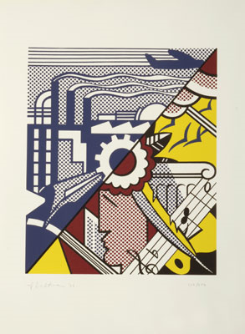
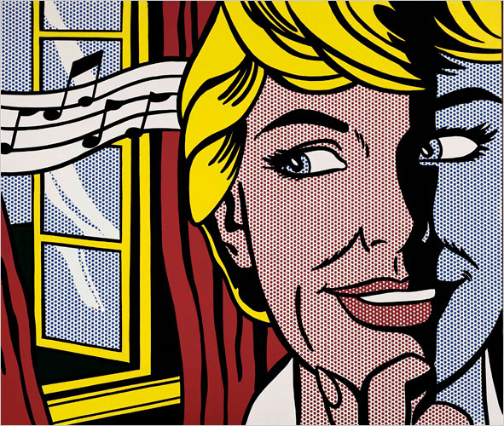
Modern Painters
Roy Lichenstein
Notes:
(1923-1997)
From his studio in New York City, Roy Lichtenstein did cartoon inspired paintings that helped launch the Pop Art movement. He was unique in that he developed a new visual language in an avant-garde style that was disruptive to viewers and yet was accessible and popular with them. He also did innovative art work that incorporated many late 20th-century movements and addressed a number of social issues.
His thirty-five year career of public recognition was celebrated in 1993-94 by The Solomon R. Guggenheim Museum in New York with a large scale retrospective of his work.
He was born in Manhattan and went to high school there. By age 14, he was taking art classes at the Parsons School of Design and also studied briefly with Reginald Marsh at the Art Students League in 1939. He then attended Ohio State University where his major influence was Hoyt Sherman, whose figure-ground relationships inspired Lichtenstein's treatment of cliche subjects.
In 1943, he was drafted into the Army and served in Europe and then returned to Ohio State, completing his BFA and MFA and then teaching at that campus. From Cleveland, Ohio, he made frequent trips to New York and started to exhibit there in 1949. In the 1950s, he used various techniques of Abstract Expressionism, did figurative work, and like many of his generation, began employing pop art images. But he was searching for a style.
In 1957, he left Cleveland to teach at New York University in Oswego, New York, and in 1961, he began teaching at Rudgers University, where one of his colleagues, Allan Kaprow, used cartoon figures. Through Kaprow, he met many renegade New York artists including Claes Oldenburg and Jim Dine; it was a circuitous return to the New York from where he had a long journey.
In 1962, he had a landmark exhibition at the Castelli Gallery that showed enlarged depictions of advertisements and comic strip images. In fact, it was gallery owner Leo Castelli who, as a major promoter of the contemporary art scene, was a key person in launching his career.
Although Lichtenstein's pop paintings had widespread popular acceptance, he began in 1965 to do Abstract Expressionism, but in contrast to others in that style, he did work that was hard and static. In the 1990s, he did large-scale abstract interiors, and he also worked in ceramics and enamelled steel.
Throughout his career, he appeared in many documentary films and did posters for entertainments including Bill Clinton's United States presidential campaign. Lichtenstein's murals are in Dusseldorf, Germany; Tel Aviv, Israel; and New York City. He died unexpectedly on September 29, 1997, from virul pneumonia, having worked until the time of his death.

Slide 8
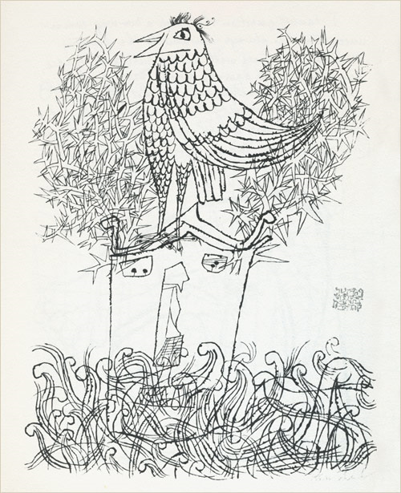
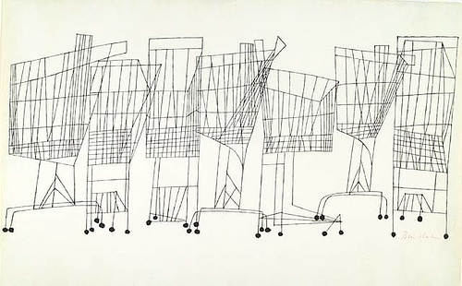
Graphic Design
Ben Shahn
Notes:
Ben Shahn (September 12, 1898 – March 14, 1969) was a Lithuanian-born American artist. He is best known for his works of social realism, his left-wing political views, and his series of lectures published as The Shape of Content.
Shahn was born in Kovno (Kaunas), Russian Empire, to Joshua Hessel and Gittel (Lieberman) Shahn. His father was exiled to Siberia for possible revolutionary activities in 1902, at which point Shahn, his mother, and two younger siblings moved to Vilkomir (Ukmergė). In 1906, the family immigrated to the United States where they rejoined Hessel, who had fled Siberia. They settled in the Williamsburg section of Brooklyn, New York where two more siblings were born. Shahn began his path to becoming an artist in New York, where he was first trained as a lithographer. Shahn's early experiences with lithography and graphic design is apparent in his later prints and paintings which often include the combination of text and image. Shahn's primary medium was egg tempera, popular among social realists.
Although Shahn attended New York University as a biology student in 1919, he went on to pursue art at City College in 1921 and then at the National Academy of Design. After his marriage to Tillie Goldstein in 1924, the two traveled through North Africa and then to Europe, where he made "the traditional artist pilgrimage."^{[1]} There he studied great European artists such as Henri Matisse, Raoul Dufy, Georges Rouault, Pablo Picasso and Paul Klee. Contemporaries who would make a profound impact on Shahn’s work and career include artists Walker Evans, Diego Rivera and Jean Charlot.^{[1]}
Shahn was dissatisfied with the work inspired by his travels, claiming that the pieces were unoriginal.^{[1]} Shahn eventually outgrew his pursuit of European modern art; he, instead, redirected his efforts toward a realist style which he used to contribute to social dialogue.^{[2]}
The 23 gouache paintings of the trials of Sacco and Vanzetti communicated the political concerns of his time, rejecting academic prescriptions for subject matter. The Passion of Sacco and Vanzetti was exhibited in 1932 and received acclaim from both the public and critics. This series gave Shahn the confidence to cultivate his personal style, regardless of society’s art standards.^{[3]}
Themes
Ben Shahn’s social-realist vision informed his approach to art. Shahn’s examination of the status quo inspired his creative process.^{[1]} Although he often explored polemic themes of modern urban life, organized labor, immigration and injustice, he did so while maintaining a compassionate tone. Shahn identified himself as a communicative artist. He challenged the esoteric pretensions of art, which he believed disconnect artists’ and their work from the public.^{[8]} As an alternative, he proposed an intimate and mutually beneficial relationship between artist and audience.
Shahn defended his choice to employ pictorial realities, rather than abstract forms. According to Shahn, known forms allow the artist “to discover new truths about man and to reaffirm that his life is significant.”^{[8]} References to allegory, the Old Testament, humanistic content, childhood, science, music and the commonplace are other motifs Shahn draws upon to make the universal personal for his viewers.^{[9]} Wit, candor and sentimentality give his images poignancy. By evoking dynamism, Shahn intended to inspire social change. Shahn stressed that in art, as in life, the combination of opposing orders is vital for progress.^{[1]} His hope for a unity among the diverse peoples of the United States relates to his interest in fusing different visual vocabularies.
[edit] Style
Shahn mixed different genres of art. His body of art is distinctive for its lack of traditional landscapes, still lifes, and portraits.^{[3]} Shahn used both expressive and precise visual languages, which he coalesced through the consistency of his authoritative line. His background in lithography contributed to his detail-oriented look ^{[8]} Shahn is also noted for his use of unique symbolism, which is often compared to the imagery in Paul Klee's drawings.^{[8]} While Shahn's "love for exactitude"^{[10]} is apparent in his graphics, so too is his creativity. In fact, many of his paintings are inventive adaptations of his photography.^{[10]}
His art is striking but also introspective. He often captured figures engrossed in their own worlds.^{[2]} Many of his photographs were taken spontaneously, without the subject's notice. Although he used many mediums, his pieces are consistently thoughtful and playful.^{[3]}
[edit] Jersey Homesteads Mural
Sacco & Vanzetti mosaic, Syracuse University, Syracuse, NY
The Farm Security Administration commissioned Ben Shahn to paint a mural for the community center of Jersey Homesteads (later renamed Roosevelt), a New Jersey town initially planned to be a community for Jewish garment workers. Shahn's move to the settlement demonstrates his dedication to the project as does his mural's compelling depiction of the town's founding.
Three panels compose the mural. According to art historian Diana L. Linden, the panels' sequence relates to that of the Haggadah, the Jewish Passover Seder text which follows a narrative of slavery, deliverance and redemption.^{[6]} More specifically, Shahn’s mural depicts immigrants' struggle and advancement in the United States.
The first panel shows the antisemitic and xenophobic obstacles American immigrants faced. During the global Depression, citizens of the United States struggled for their livelihoods. Because foreigners represented competition for employment, they were especially unwelcome. National immigration quotas also reflected the strained foreign relations of the United States at a time when fascism, Nazism, and communism were on the rise. To illustrate the political and social adversary, Shahn incorporated loaded iconography: Nazi soldiers, anti-Jewish signs and the executed Italian anarchists, Sacco and Vanzetti. Below, Shahn's mother and Albert Einstein lead immigrants on a gangplank situated by the Ellis Island registry center and the Statue of Liberty. This section demonstrates the immigrants' heroic emergence in the United States.
The middle panel describes the poor living conditions awaiting immigrants after their arrival. On the right, Shahn depicts the inhuman labor situation in the form of "lightless sweatshops...tedious and backbreaking work with outmoded tools."^{[10]} The crowd in the center of the composition represents labor unions and workers' reform efforts. Here, a figure resembling labor leader John L. Lewis protests in front of the Triangle Shirtwaist Company, where a devastating fire occurred and the movement for the International Ladies' Garment Workers Union (ILGWU) began. The lower right passageway marked ILGWU symbolizes a new and hopeful path, in United States, paved by unionized labor.^{[10]}
In the last panel, the unions and the New Deal unite to create the blueprint for the town of the Jersey Homesteads. Various figures of social progress such as Sidney Hillman and Heywood Broun gather around the drafting table. Above them are images of the purposed cooperative farm and factory along with a campaign poster of Roosevelt, after whom the town was eventually named.

Slide 9
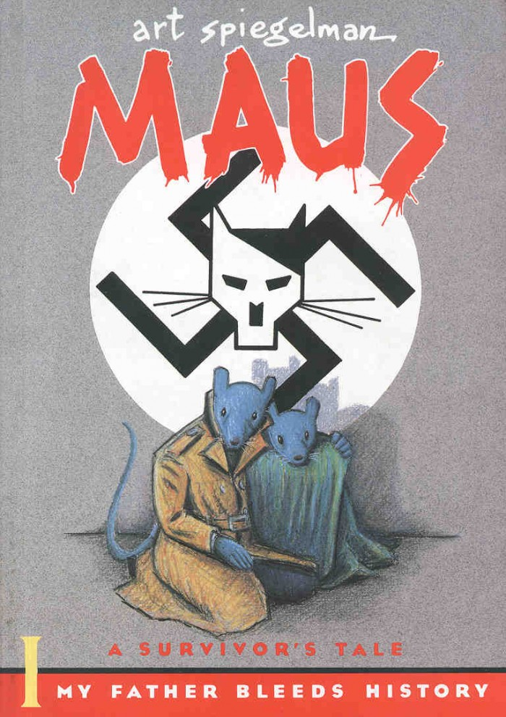
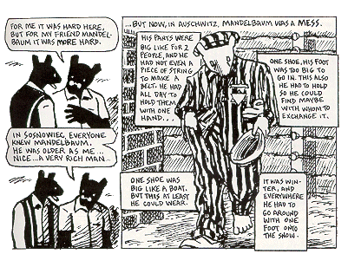
Graphic Design
Art Spiegelman
Notes:
Art Spiegelman was born in Stockholm, on February 15, 1948. He grew up in Rego Park, NY. Attended the M.S of art anddesign, followed by two and a half years at Harper College, SUNY Binghamton and a month in Binghamton State Mental Hospital. He received an honorary doctorate of letters from SUNY Binghamton in June 1995.
He began working for Topps Gum Co. in 1966, were he stayed for almost twenty years. There he created novelty cards, stickers and candy products. Some of his creations include: garbage candy, wacky packages and garbage pail kids. He began doing underground comix in 1966.
He moved in San Fransisco from 1971-1975 where Comix appeared in East Village. He moved back to New York City and began doing drawings and comix for the New York Times, Village voice and Playboy. He also became an instructor at the School of Visual Arts. In 1979 he co-founded RAW magazine with his wife.
He published the first half of Maus: A Survivor's Tale in 1986 and the second in 1991. He received National Book Critics Circle Nominations for both books. He got the Special Pulitzer Prize in 1992. MAUS has been published in twenty different languages.
Art currently lives with his wife and two children in Lower Manhattan.

Slide 10
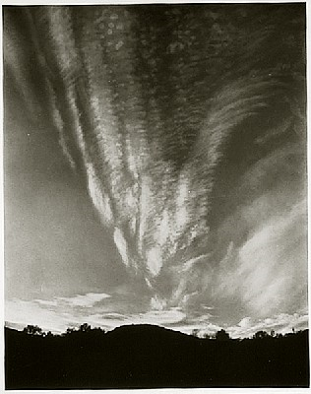
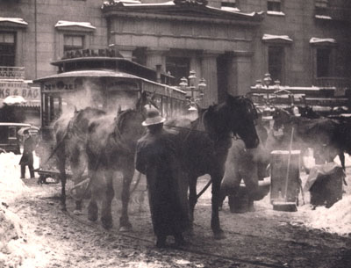
Photographers
Alfred Stieglitz
Notes:
(1864-1946)
Alfred Stieglitz was an American photographer who was instrumental in the acceptance of photography as an art form alongside painting and sculpture. He was born on January 1, 1864 in Hoboken, New Jersey to prosperous German Jewish immigrants, the eldest of six children. In 1881, Stieglitz’s father moved the family to Berlin so that Alfred could receive a German education. Stieglitz began studying mechanical engineering at the Technische Hochschule in Berlin, but after developing his first photograph in 1883, he changed his concentration from engineering to photochemistry.
During the summer of 1886, Stieglitz traveled throughout the European countryside taking photographs. These included many photos of peasants working on the Dutch seacoast as well as undisturbed nature within Germany’s Black Forest. In the same year, Stieglitz entered his first club and magazine competitions and in 1887, won first prize for “A Good Joke” from the magazine Amateur Photographer. Also at this time British and German periodicals began to publish Stieglitz’s photographs.
Stieglitz returned to NY in 1890 and became a partner at Photochrome Engraving Company. A year later he joined the society of amateur photographers and in 1892 acquired the first four-by-five inch hand-held camera, with which he photographed New York City. In 1893 Stieglitz married Emmeline Obermeyer, with whom he would have a daughter named Katherine (Kitty) in 1898. Between 1893 and 1896, Stieglitz served as Chief Editor of the American Amateur Photographer.
In 1894, Stieglitz’s work was exhibited at the first International Salon at the Photo Club of Paris. One year later, he chose to leave the Photochrome Engraving Company in order to concentrate on photography. In 1896 Stieglitz was asked to resign as Chief Editor of the American Amateur Photographer because his autocratic style had alienated many subscribers. In 1897, R. H. Russell published a photo collection of Stieglitz’s work, entitled Picturesque Bits of New York. Two years later, Stieglitz presented his first solo retrospective exhibit at the Camera Club, featuring eighty-seven prints taken between 1885 and 1899. In 1903, Stieglitz began editing and publishing Camera Work.
During the first part of his career, Stieglitz led the Pictorialist movement, which advocated for the acceptance of photography as an art form just like drawing or painting. Pictorialists believed that, like a paintbrush, a camera could be used as a tool to create a manmade piece of art. They often also manipulated their photographs in the darkroom to further illustrate their part in the process and therefore earn the acceptance of their work as art. It was not the scenes that were being photographed alone that were art, but rather the way the photographer shaped the picture to express his/her own artistry. As a Pictorialist editor of Camera Work, Stieglitz announced that every image published would be a picture, not a photograph. Stieglitz was also influenced by the modern art scene, especially by the Impressionist movement that had embraced the city as a subject worthy of representation. Like European Impressionists, he chose to photograph the modern city, often represented by steam engines.
In 1905, Stieglitz opened The Little Galleries of the Photo-Secession, later known simply as 291, where he exhibited the work of photographers who had been published in Camera Work. The gallery later became a place to showcase the masters of European modernism, including Auguste Rodin in 1908 and Henri Matisse. Stieglitz even convinced Pablo Picasso to hold his first solo exhibition at 291 in 1911. The gallery also promoted the work of some American artists, including the then unknown, Georgia O’Keeffe. The last issue of Camera Work was published in 1917, the same year that 291 closed its doors.
“The Steerage,” which Stieglitz photographed in 1907, marks a turning point in Stieglitz’s career. It was in this photograph that Stieglitz abandoned the idea that photographs should look like paintings and began to explore photography in its own right. From this time on, Stieglitz took “straight” photographs in sharp focus, no longer using techniques to create the appearance of brushwork. In 1910, Stieglitz organized the “International Exhibition of Pictorial Photography” in Buffalo, NY. While he began to support photographs as photographs, Stieglitz did not change his opinion of the definition of art. In 1923 Stieglitz wrote, “My photographs look like photographs and they therefore can’t be considered art.”
In 1917, Stieglitz first photographed O’Keeffe. A year later, he left his wife and daughter and moved to NY with O’Keeffe. He divorced his wife and married O’Keeffe in 1924. That same year, an exhibition held at Anderson Galleries exhibited sixty-one of Stieglitz’s prints alongside fifty-one of O’Keeffe’s paintings.
Stieglitz opened the Intimate Gallery in 1925. After only twenty exhibitions, he closed the Intimate Gallery and opened An American Place in 1929. Stieglitz’s last solo exhibition was held at An American Place in 1934.
During the 1930’s, Stieglitz took a series of portraits of Dorothy Norman and O’Keeffe. These photographs were the first to recognize the artistic potential of isolated parts of the human body. In 1933, Stieglitz presented a gift of over 1000 works of art from over 100 artists to the Metropolitan Museum of Art and in 1941, the Museum of Modern Art acquired a group of Stieglitz’s photographs. Stieglitz died on July 13, 1946 of heart disease.

Slide 11
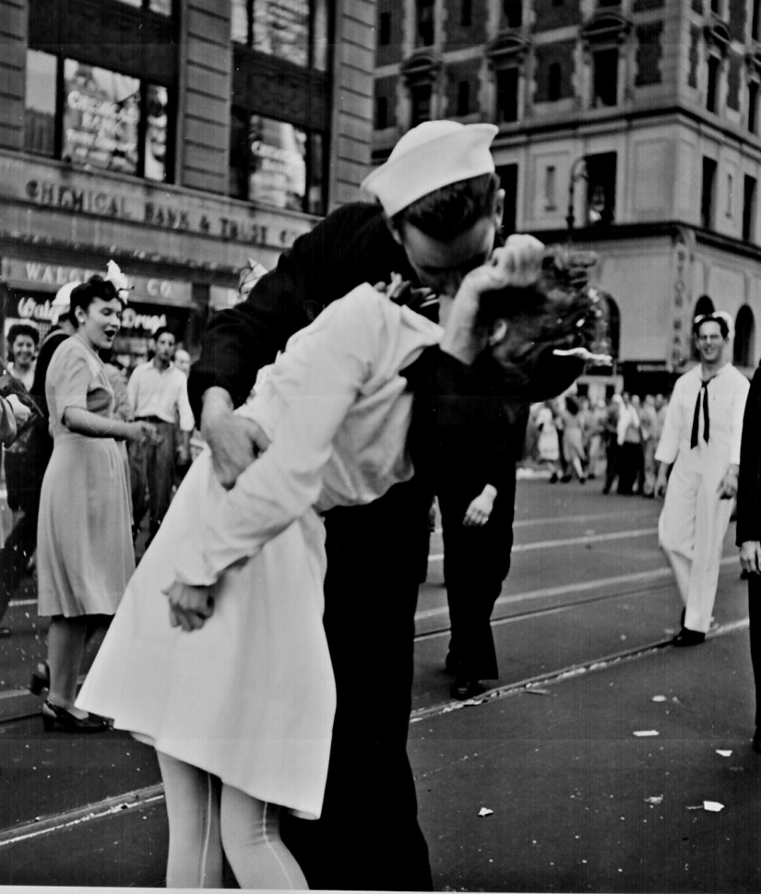
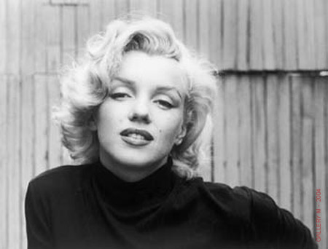
Photographers
Alfred Eisenstaedt
Notes:
(1898–1995)
“It’s more important to click with people than to click the shutter.”
Eisie, as he was known to his friends, was born in Dirschau, West Prussia, now part of Poland. At age 29 he first picked up a camera in earnest. He took more than a million photographs in his lifetime. Fascinated by the long shadows cast by the afternoon sun, he shot what was to be his first published picture - a woman playing tennis - for which he received 12 marks — about $3.00.
Among the first to use a 35mm camera, Eisenstaedt took candid photographs with available light and helped to define the art of photojournalism. His pictures let people and events speak for themselves. His job was to find and catch the storytelling moment.
Eisie, known as the “Father of Photojournalism,” emigrated to the U.S. in 1935 and became one of the four original photographers at LIFE, where he produced more than 2,500 assignments and 92 covers. He was, as the title to one of his 13 books states, A Witness To Our Time. Eisie photographed more of the world's famous faces and had more photographs published than any other photographer in history.
Since 1999, the Alfred Eisenstaedt Awards for Magazine Photography have been administered by the Columbia University Graduate School of Journalism.

Slide 12
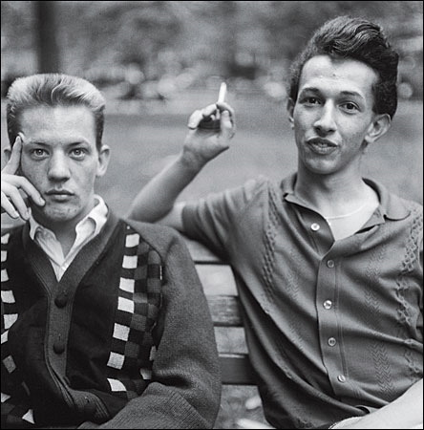
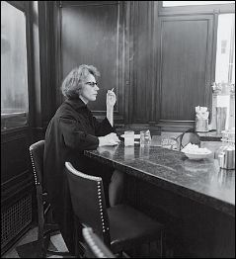
Photographers
Diane Arbus
Notes:
(1923-1971)
Diane Arbus was born, to a wealthy Jewish family, in 1923. David Nemerov, her father, was the hard-working son of a Russian immigrant; her mother Gertrude was the daughter of the owners of Russek's Fur Store. After the marriage, David helped manage Russek's, and oversaw its transformation into a department store, Russek's of Fifth Avenue, which specialized in furs. His interest, however, was in women's clothing, and he was said to have an extraordinary intuition for what the next trend in women's fashion would be.
Diane (pronounced Dee-Ann ) was a privileged child, raised with her two siblings in large apartments on Central Park West and Park Avenue. She later told Studs Terkel, for his Hard Times: An Oral History of the Depression , "I grew up feeling immune and exempt from circumstance. One of the things I suffered from was that I never felt adversity. I was confirmed in a sense of unreality."
The wealth was complicated, as it often is, by distant parents: her father was kept away by work and her mother by depression. She was loved more than she was known. In her New Yorker review of two new Arbus exhibits -- Family Albums , at the Mount Holyoke College Museum of Art, and Revealed , at the San Francisco Museum of Modern Art -- Judith Thurman writes of Arbus, "Her heritage was, in fact, that of most artistic children of privilege, who feel that their true selves are invisible, while resenting the dutiful, false selves for which they are loved: a dilemma that inspires the quest, in whatever medium, for a reflection."
She was luminous, with large green eyes, a delicate, exotic face and a slim body. And she was, writes Thurman, "nubile" (almost every published photo of her has a sexual charge to it). All kinds of people were captivated by her, and she was captivated by all kinds of people.
At the age of 13, she met Allan Arbus, an employee in the advertising department of her parents' store, and they married, with her parents' grudging assent, after she turned 18. After the war, during which Allan studied photography in the New Jersey Signal Corps, the couple supported themselves, and daughters Doon and Yolanda, as fashion photographers (the family money, somehow, never materialized for Arbus as an adult).
Though the work was divided along traditional gender roles, with Allan at the camera and Diane as the stylist/art director, they had a supportive relationship. Allan gave Diane her first camera, and they took equal credit on their published photos. In 1956, a year after a photo of theirs was included in curator Edward Steichen's massive Family of Man exhibition at the Museum of Modern Art (MOMA), Allan supported her decision to leave the fashion business to him to pursue her own interests.
The professional separation was followed, in 1959, by a marital separation. They remained close friends, however, and his laboratory assistants developed her film until, in 1969, he re-married and moved to California to become an actor (he played psychiatrist Dr. Sidney Freedman on M.A.S.H. ). The fraying of their marriage, though difficult for her, coincided with an efflorescence in her art. "I always felt that it was our separation that made her a photographer," Allan recently told the New York Times . "I couldn't have stood for her going to the places she did. She'd go to bars on the Bowery and to people's houses. I would have been horrified."
As important to her evolution was a class she took with Lisette Model, a European émigree and photographer who encouraged Arbus, on the one hand, to push further into her thematic interest in unorthodoxy, and, on the other hand, to master the conventional technical aspects of photography.
By the early '60s, her commercial portraits, for magazines such as Esquire and Harper's Bazaar , began to assume a distinctive look. Though taken of mainly traditional subjects -- actors, writers, activists -- they were strange and obscurely troubling. She would spend hours with her subjects, following them to their homes or offices, talking and listening to them, trying to soften them up to the point where they began to drop their public façade
"In nearly every case," writes Harold Hayes, one of her editors at Esquire , "her subject would be framed by his most natural, obvious setting ... and posed facing straight-eyed and unblinking toward the center of her camera lens, always with the same curious expression, as though seeking from the beholder some special understanding."
Her non-commercial work, for which she was awarded Guggenheim fellowships in 1963 and 1966, oriented toward the unfamous -- a couple on a park bench, a young Republican, identical twin girls -- and the marginal: dwarves, drag queens, circus performers.
In 1962, she met John Szarkowski, who had replaced Edward Steichen as the curator of photography at MOMA and brought with him a romantic, subjective aesthetic of photography: a visual counterpart to the New Journalism
of writers like Norman Mailer and Tom Wolfe. In 1967, Szarkowski featured Arbus in the movement's manifesto/exhibition, New Documents . That show, more than any other, established her reputation.
In July of 1971, at the age of 48, during a bout of depression, she committed suicide (pills and a razor blade). The following year, MOMA held a retrospective of her work; it became the most attended solo photography exhibition in its history, and the monograph that followed, edited by Doon Arbus and Marvin Israel, one of the best-selling art books in history.
The images, from the retrospective and the monograph, have seeped into the public consciousness. Her depictions of suburban ennui and shriveled post-celebrity have become archetypal. Photos such as "Identical Twins," "A young man in curlers," and "A Jewish giant at home with his parents," along with a number of the untitled photos she took at institutions for the severely retarded, are as recognizable in themselves as, for instance, Walker Evans' pictures of poor Southern sharecroppers from Let Us Now Praise Famous Men . Like Evans, who was a friend and influence, her style has been prodigiously imitated.
Arbus continues to fascinate, thirty years later, for a number of complementary reasons. The photos are amazing to look at, startling even now, when images of the downtrodden and the marginal have become the common property of advertisements and movies. And they are formally innovative, marrying the conventions of 19th century portrait photography --face-front, amongst one's things, subject in collaboration with photographer -- to the seamy concerns of the 1960s.
Her story, also, fits the popular '60s template of the romantic, tragic, brilliant, unconventional, tortured artist -- Sylvia Plath, Janis Joplin, Jim Morrison, Jimi Hendrix -- who was too beautiful to survive in the fallen world.
Finally, there is the question, both implicit in her photographs and central to her biography: Why did they let her do this to them? Why did the transvestite bring her home to his apartment and allow her to expose his un-normalcy -- what at the time would have been called deviancy -- to the world? Why did the institutions allow her access to the retarded under their care, and to what extent could the retarded have given consent? Did the "normal" people she photographed know that she would catch them precisely at the moment when, for whatever reason, they looked most freakish?
Arbus, perhaps more than any other photographer before and after, forces us to question the morality of photography. What is it that we're doing when we take a picture, and what gives us the right? In 1973, Susan Sontag, whom Arbus had once photographed, wrote what is still the most-cited essay on Arbus, in which she accused her, essentially, of nihilism.
The essay, first published in the New York Review of Books , became the fulcrum of On Photography , a collection of essays that Sontag wrote, in part, to justify her fascination with and repulsion for Arbus, and in which she used Arbus to explore the politics of photography.
"The images that mobilize conscience," writes Sontag, "are always linked to a given historical situation. The more general they are, the less likely they are to be effective."
Photographs, writes Sontag, tend to diminish and atomize experience. They inure us, through repetition, to horror. They protect us, and distance us, from the valuable anxiety of unfamiliar places and situations. They misrepresent themselves as reality, as capturing the essence, in two dimensions, of a world that is four-dimensional (the fourth dimension, in particular, being slighted). "Photography," she writes, "implies that we know about the world if we accept it as the camera records it. But this is the opposite of understanding, which starts from not accepting the world as it looks."
Arbus' photos are for Sontag the worst kind of perpetrators of this fraud: unhistorical, unpolitical, unrealistic portraits that masquerade as precisely the opposite. Arbus' brilliance was to catch everybody unmasked, at the moment of transition between unconscious repose and practiced, social self-representation. People seemed to reveal, in that moment, their essential being, which was alienated and miserable (an Arbus photo, according to legend, revealed the misery of an otherwise happy-seeming woman soon before her suicide).
The shock of the photos is in part that they suggest to us that were Arbus standing before us with her camera, we wouldn't perform much better, and that therefore, perhaps, we're as miserable as the woman on the park bench, as freakish as the transvestite in curlers (who at least is aware of, and in dialogue with, his freakhood). "Arbus's photographs," writes Sontag, "undercut politics ... by suggesting a world in which everybody is alien, hopelessly isolated, immobilized in mechanical, crippled identities and relationships."
To Sontag, Arbus was a voyeur from the Upper West Side, a coddled depressive, a disillusioned fashion photographer, an emotional midget with an exquisite eye who sought out the marginal and the sensational because, in habituating herself to their horror, she hoped to numb her own pain. She is emblematic of the paradox of photography, that "a pseudo-familiarity with the horrible reinforces alienation, making one less able to react in real life." Arbus' suicide, from this perspective, becomes not a proof of her sincerity, as others have read it, but a consequence of her compulsive insincerity.
Arbus' photos are so undeniable in their effect that, even when the response is approving, it's expressed in similarly troubled terms. Janet Malcolm, whose The Journalist and the Murderer is the definitive meditation on the parasitic relationship between an artist and her subject, describes Arbus, in Diana & Nikon , as "a straight woman from a rich Jewish family that made its money in fur [who] has penetrated a sordid closed world and, through her journalist's too-niceness, become privy to its exciting and pathetic secrets."
Whereas for Sontag, Arbus' photos dissolve the difference between misery and normality, and thus blunt our compassion for the miserable, for Malcolm Arbus exacerbates the difference, exposes what the well-fed and well-formed feel, but loathe to acknowledge, when confronted with physical and emotional deformity.
"In photographing the retarded," Malcolm writes, "[Arbus] waits for the moment of fullest expression of disability: she shows people who are slack-jawed, vacant, drooling, uncoordinated, uncontrolled, demented-looking. She does not flinch from the truth that difference is different, and therefore frightening, threatening, disgusting. She does not put herself above us -- she implicates herself in the accusation."
Arbus herself, so far as we know, didn't like to describe her art in moral terms. She was, depending on your level of skepticism, earnest or calculatingly naïve in admitting the selfishness of her motives. She photographed what she did, she said, because that was what interested her, and because nobody else was.
"Freaks was a thing I photographed a lot," she wrote. "It was one of the first things I photographed and it had a terrific kind of excitement for me. I just used to adore them. I still do adore some of them. I don't quite mean they're my best friends but they made me feel a mixture of shame and awe. There's a quality of legend about freaks. Like a person in a fairy tale who stops you and demands that you answer a riddle. Most people go through life dreading they'll have a traumatic experience. Freaks were born with their trauma. They've already passed their test in life. They're aristocrats."
Arbus is remembered as a chronicler of freaks -- because that's how she cast herself, and because her suicide casts a garish shadow back on what we presume, maybe too easily, was the freakishness of her inner life. And because it's still, all these years later, easier to contemplate who she was than it is to step behind her lens and contemplate the people she photographed.

Slide 13
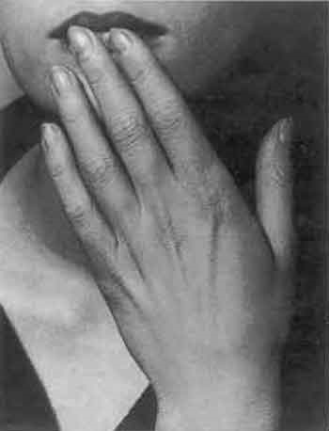
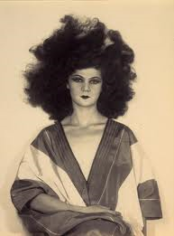
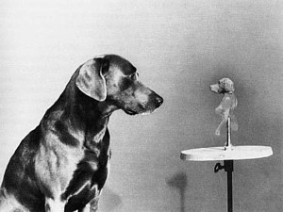
Photographers
Man Ray
Notes:
(1890-1976)
Man Ray, was born Emmanuel Radnitzky on August 27, 1890, in Philadelphia, Pennsylvania. Ray was raised in Brooklyn and in 1908, graduated from Boy’s High School. In 1911, the Radnitzky family chose to change their surname to Ray, to avoid anti-Semitism and discrimination.
In 1915, Ray presented his first collection of paintings and drawings. However, it was not until 1918, that he produced his first significant photograph exhibit. Along with friend, Marcel Duchamp, Ray formed the American branch of the Dada movement, which began in Europe as a rejection of traditional art. He then founded the group of modern artists called “Others.”
In July 1921, Ray went to live in Paris, France. During the next few decades in France, Ray transformed the art of photography. In 1925, his work was presented in the first Surrealist exhibition at the Gallerie Pierre in Paris. It was during this time, that Ray invented the photographic technique of solarization, in which the image recorded on a negative is wholly or partially reversed in tone.
Ray would later return to the United States in 1940, one step ahead of the Nazis, settling in Los Angeles, California. Nevertheless, in 1951 he would again return to France, where he would remain until his death. Ray died on November 18, 1976.

Slide 14
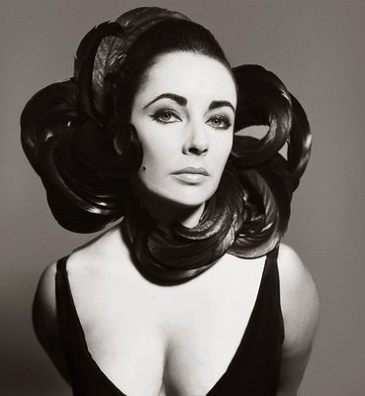
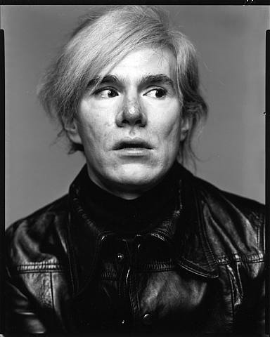
Photographers
Richard Avedon
Notes:
(1923-2004)
One of the leading photographers of the century, New York City native Richard Avedon was a restless and relentless chronicler of our time for more than 50 years. "No one has given a nation a more wide-ranging, disciplined photographic document of itself," John Lahr noted in The Times of London. A prize-winning poet in high school, Avedon dropped out and joined the Merchant Marines in 1942. With his father's going-away gift in hand-a Rolleiflex camera-he applied to the Merchant Marines' photography branch and among other assignments, took identification photographs of personnel. After the war, Avedon became the chief photographer for Harper's Bazaar in the late '40s. There, for two decades, he elevated fashion photography to an art form, shattering the conventional mold that models should project indifference. Instead, Avedon's models laughed, danced, played in the rain, embraced athletes and engaged in other emotional vignettes.
In 1959, he published Observations, a book of photographs with text by Truman Capote. He photographed the civil rights movement in the South in 1963 and, the following year, collaborated with James Baldwin on the book Nothing Personal. In 1966, he left Harper's Bazaar to become staff photographer at Vogue. In the late '60s and early '70s, Avedon photographed antiwar protesters in the United States and military leaders and war victims in Vietnam. One New Year's Eve 1989-90, he documented the night East and West Berlin became one. Avedon became the first-ever staff photographer for The New Yorker in 1992.
Avedon brought a new focus to portrait photography, revealing unexpected facets of people-from the world famous to the unknown — against a white background. "A portrait is not a likeness. The moment an emotion or fact is transformed into a photograph it is no longer a fact but an opinion. There is no such thing as inaccuracy in a photograph. All photographs are accurate. None of them is truth," he said.
Avedon had many major exhibitions, including a 1970 portrait retrospective at the Minneapolis Institute of Arts; photographs of his father, Jacob Israel Avedon, at the Museum of Modern Art in New York in 1974; "Avedon: Photographs 1947-1977," a retrospective of his fashion work, at the Metropolitan Museum of Art in New York, and "Avedon 1946-1980 at the University Art Museum in Berkeley, California. In 1985, "In the American West" opened at the Amon Carter Museum in Fort Worth. In 1994, the Whitney Museum of American Art in New York exhibited "Evidence," a retrospective of his work which then toured the world. Most recently, the Metropolitan Museum of Art honored his work as a portrait photographer in the retrospective "Richard Avedon Portraits."
In addition to Observations and Nothing Personal, Avedon published nine other books, including Alice in Wonderland, Portraits, Photographs 1947-1977, In the American West, An Autobiography, Evidence, The Sixties, Made in France and Richard Avedon Portraits.
He was the recipient of numerous awards and honors, including the University of California, Berkeley, Chancellor's Citation (1980); Harvard University, Certificate of Recognition (1986-87); Royal College of Art, London, Honorary Doctorate (1989); Erna and Victor Hasselblad Foundation International Photography Prize (1991); the International Center of Photography Master of Photography Award (1993); induction into the American Academy of Arts and Sciences (2001); the Royal Photographic Society 150th Anniversary Medal (2003); the Arts & Business Council Award for Outstanding Achievement in the Visual Arts (2003); and Americans for the Arts National Arts Award for Lifetime Achievement (2003).
Avedon was married in 1944 to Dorcas Nowell, a model known professionally as Doe Avedon. After five years, they divorced and in 1951, he married Evelyn Franklin, but they also separated.
Hollywood presented a fictional account of his early career in the 1957 musical Funny Face, starring Fred Astaire as the fashion photographer "Dick Avery."
On September 25, 2004, he suffered a brain hemorrhage in San Antonio, Texas while shooting an assignment for The New Yorker. He died in San Antonio on October 1. At the time of his death, Avedon was working on a new project entitled “On Democracy.” The project focused on the run-up to the 2004 U.S. presidential election, and featured portraits of the candidates, delegates to the national nominating conventions, and others.

Slide 15
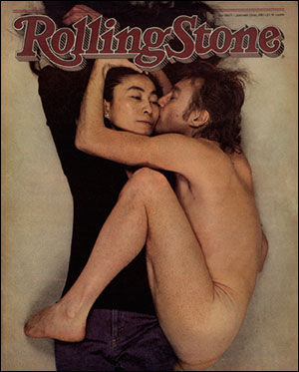
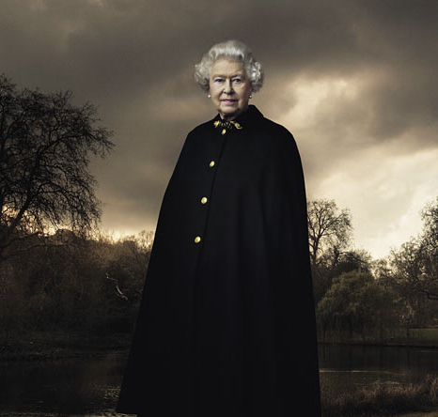
Photographers
Annie Leibovitz
Notes:
(1949 - )
Anna-Lou (Annie) Leibovitz, born in Westbury, Connecticut, is an American photographer. She is most noted for her portraits of rock and roll personalities, including many taken for Rolling Stone and in current years for Vanity Fair. She was photographer of celebrities for a remarkable international campaign for American Express charge cards in the 1980s. Leibovitz was the long-term partner of Susan Sontag until Sontag's death in 2004.
Some of her well-known photos include:
A nude John Lennon hugging a clothed Yoko Ono, taken in 1980 the morning before Lennon's death.
A nude Demi Moore with a suit painted on her body.
Whoopi Goldberg lying in a bathtub full of milk, shot from above.
A fully-wrapped Christo, for which we have to take the artist's word that it is actually Christo under the wrap.

Slide 16
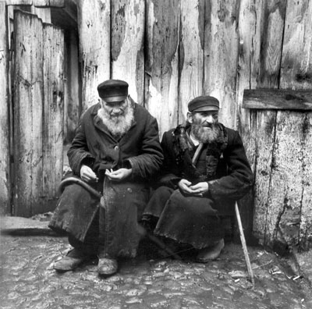
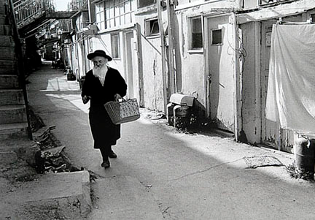
Photographers
Roman Vishniac
Notes:
(1897-1990)
Roman Vishniac was a Russian-American photographer, accomplished biologist, linguist, art historian, and philosopher. As a photographer he was best known for his photographs of Central and Eastern European Jewry prior to the Holocaust, however has also made significant scientific contributions to the fields of photomicroscopy and time-lapse photography. Extremely interested in history, especially Jewish history, Vishniac had a strong Jewish identity and was a Zionist later in life. He won international acclaim for his photographs from the shetl and Jewish ghettos, his celebrity portraits, and images of microscopic biology.
Vishniac was born on August 19, 1897 in Pavlosk, near St. Petersburg, and grew up in Moscow. Few Jews were permitted to live inside the city of Moscow, but since Vishniac’s father, Solomon, was a wealthy umbrella manufacturer and his mother, Manya, was the daughter of affluent diamond dealers, the family was granted permission to reside within the city. Vishniac’s fascination with biology and photography began at an early age. When his grandmother gave him a microscope for his seventh birthday, Vishniac hooked it up to a camera and photographed the muscles in a cockroach’s leg magnified 150 times. He used this microscope extensively, viewing and photographing everything he could find, from dead insects to animal scales, to pollen and protozoa.
Beginning in 1914, Vishniac spent six years at Shanyavsky Institute (now University) in Moscow. While enrolled there, he served in the Tsarist, Kerensky and Soviet armies. He earned a Ph.D. in zoology and became an assistant professor of biology at the Institute. As a graduate student, he worked with prestigious biologist Nikolai Koltzoff, experimenting with inducing metamorphosis in axolotl, a species of aquatic salamander. While his experiments were a success, Dr. Vishniac was not able to publish a paper detailing his findings due to the chaos in Russia and his results were eventually independently duplicated. In spite of this, he went on to take a three-year course in medicine.
In 1918, the Third Russian Revolution triggered a rise in anti-Semitism that caused Vishniac’s immediate family to relocate to Berlin. He followed soon after and married Luta (Leah) Bagg. They had two children, Mara and Wolf. Vishniac worked various jobs in order to support his family. In his spare time, he studied Far Eastern Art at the University of Berlin, researched endocrinology and optics, and took some photography. It was also during this time that Vishniac began his public speaking career by joining the Salamander Club, where he gave lectures on naturalism.
Between 1935 and 1939, as anti-Semitism was growing in Germany, Vishniac traveled to Eastern Europe and took his acclaimed photographs of the culture of poor Jews in mountainous villages and urban ghettos. At first commissioned by the American Jewish Joint Distribution Committee as part of a fundraising initiative, Vishniac was so affected by the project that he chose to continue it even after the commission was complete. He traveled to the ghettos of Russia, Poland, Romania, Czechoslovakia, and Lithuania for years after he worked for the Committee. Aware of Hitler’s mission to exterminate the Jews, Vishniac was intent on preserving the memory of the Jewish people. He also hoped to promote awareness of the atrocities that were occurring in Nazi territories. In late 1938, Vishniac sneaked into Zbaszyn, an internment camp in Germany near the border, where Jews awaited deportment to Poland. After photographing the “filthy barracks” for two days, he escaped. Vishniac then submitted his photographs to the League of Nations as proof of the existence of such camps.
In order to take the more than 16,000 photographs of Eastern European Jewry, Vishniac used a hidden camera, both to avoid charges of spying and because many Orthodox Jews would not have their picture taken. He was arrested eleven times during this time for taking pictures, often because he was thought to be spying. Vishniac managed to preserve 2,000 of these photographs, hidden by himself and his family and smuggled into America by Walter Bierer through Cuba. The surviving photographs would later be showcased as part of one-man shows at Columbia University, the Jewish Museum, the International Center of Photography, as well as at some other institutions.
While visiting Paris in 1940, Vishniac was arrested by the Pétain police for being a “stateless person,” and was interned at Camp du Ruchard, a deportation camp in Clichy, France. He stayed there for three months until his wife was able to obtain visas for the family to move to the United States. His parents remained in Europe. Vishniac’s mother died from cancer in 1941 and his father spent the war in hiding in France. Vishniac sewed some of his negatives into his clothing when he came to America, but his father hid the bulk of the surviving negatives with him in France.
In 1940,Vishniac settled in New York City with his family. He spoke German, Russian, and Yiddish, but no English and found it difficult to find employment. Vishniac took some portraits for mostly foreign clients, but generally struggled to find work. It was during this time that Vishniac took his celebrated portrait of Albert Einstein. In 1943, his work on Eastern European Jewry was exhibited at Teacher’s College, Columbia University. Vishniac hoped to promote awareness of the plight of Eastern European Jews, and even wrote to Eleanor Roosevelt, then First Lady, to request she visit his exhibit.
In 1946, Vishniac divorced Luta and a year later married Edith Ernst, an old family friend. A few years later, he gave up portraiture and went on to do freelance work in the field of photomicroscopy. In 1947, A Vanished World was published, one of the first pictorial documentations of Jewish culture in Eastern Europe during that time period. Ten years later, Vishniac was appointed to be research associate at the Albert Einstein College of Medicine and in 1961 became a professor of biological education. He later became “Chevron Professor of Creativity” at Pratt Institute. Vishniac also taught Oriental and Russian art, general philosophy and religion in science, specifically focusing on Jewish topics, ecology, numismatics, photography, and general science at City University of New York, Case Western Reserve University, and several other institutions.
Vishniac was the project director and filmmaker for the Living Biology series sponsored by the National Science Foundation, which consisted of seven films focused on cell biology, organs and systems, embryology, evolution, genetics, ecology, botany, the animal world, and the microbial world. He was a pioneer in time-lapse cinematography and light-interruption photography and in the color photomicroscopy of living organisms. Vishniac’s main area of research was in marine microbiology, the physiology of ciliates, and circulation systems in unicellular plants. He hypothesized that the first living organisms were muticellular structures that emerged at many different times and places by varying biochemical pathways. In 1971, Building Blocks of Life was published, documenting Vishniac’s color microphotographs of proteins, vitamins, and hormones.
Vishniac received the Memorial Award of the American Society of Magazine Photographers in 1956 and was the winner of the visual arts category of awards of the Jewish Book Council in 1984. His photograph, The Only Flowers of her Youth, was acknowledged as “most impressive” by the International Photographic Exhibition in 1952 and he received the Grand Prize of Art in Photography from the New York Coliseum. Vishniac also received Honorary Doctoral degrees from the Rhode Island School of Design, Columbia College of Art, and the California College of Art. When he died of colon cancer on January 22, 1990, his collection of artifacts included a 14th-century Buddha, Chinese tapestries, Japanese swords, various antique microscopes, valued old maps and venerable books.

Slide 17
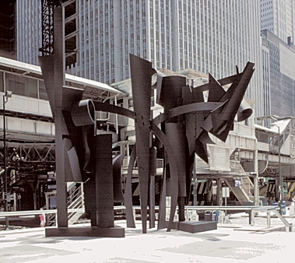
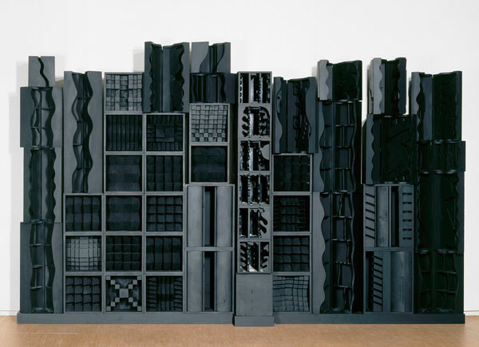
Mixed Media/Sculpture
Louise Nevelson
Notes:
(1899-1988)
by Seymour "Sy" Brody
Near the World Trade Center in New York City is an area that is named Louise Nevelson Plaza in honor of a great American Jewish sculptor.
Louise Nevelson was born on September 23, 1899 in Kiev, Russia, to Mina Sadie and Isaac Berliawsky. Her father was a contractor and a lumber merchant. In 1902, he immigrated to the United States leaving his family in Russia. Louise felt deserted by her father's departure and was so traumatized that she stopped talking for six months. In 1904, they sold their home and with the money that her father sent, they left for the United States.
They settled in Rockland, Maine, where there were only thirty Jewish families. Her father became a successful builder, lumberyard owner and realtor. They had a beautiful home and quickly adjusted to their new life in America.
Louise had strong ties to the family, especially her father. He advocated equal rights for women. Her mother was a beautiful woman who was a freethinker. Louise knew at an early age that she wanted to be an artist. Being a Jew and wanting to be an artist, stigmatized her as she grew up. After she graduated from high school, in 1918, she met and married Charles Nevelson of New York.
For the first few years of her marriage, she studied drawing, painting, dramatics and dance. In 1922, she gave birth to her only child, Myron, who later became a famous sculptor. The expectations of her husband that she would fit into the mold of upper-middle class matrons playing mahjong and drinking tea was resented by Louise. In 1931, they separated and she never asked for alimony or support from her husband.
She took her son to her parents in Maine and she went to Munich, Germany, to continue her art studies. She was in Munich six months when the Nazis closed her art studies school.
She returned to the United States in 1937 and taught at the Educational Alliance Art School on the Lower East Side of New York City as part of a WPA-funded program.
Her first public showing of her sculpture was in 1933. Two years later, some of her work was part of an exhibit in the Brooklyn Museum. She managed to survive by selling some pieces of her works. Her reputation as a sculptor grew and, as she exhibited, she sold more of her works.
In 1967, she had a woman's show at the Whitney Museum which became the turning point of her life. She continued to create and exhibit her works during the seventies and the eighties. In 1964, Nevelson created "Homage to 6,000.000," a memorial to the Jews killed in the Holocaust. She was about to donate to the Centre Beaubourg in Paris, a work worth about S125,000, when the French government released a Palestinian terrorist. She compared this action to the "Hitler era." In protest, she withdrew her donation of her work to the museum.
Louise Nevelson is a woman with an independent mind who threw off the shackles of restrictions and confinement of her life. Her works are a tribute and a testimonial to an outstanding sculptor, who wasn't intimidated by new ideas and creativity in art.
This is one of the 150 illustrated true stories of American heroism included in Jewish Heroes & Heroines of America : 150 True Stories of American Jewish Heroism, © 1996, written by Seymour "Sy" Brody of Delray Beach, Florida, illustrated by Art Seiden of Woodmere, New York, and published by Lifetime Books, Inc., Hollywood, FL.

Slide 18
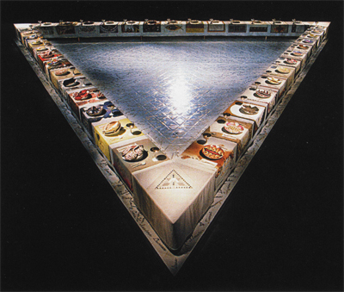
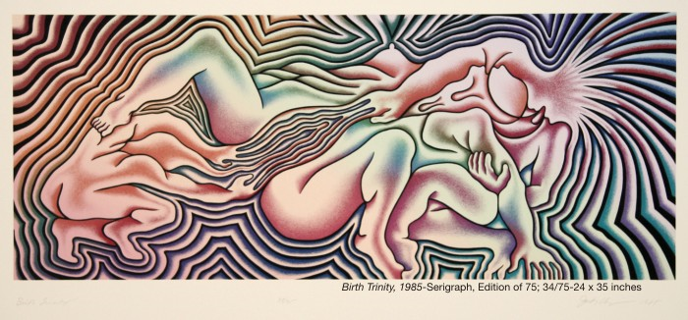
Mixed Media/Sculpture
Judy Chicago
Notes:
(1939- )
Born: Chicago, IL, 1939
Education:
Bachelor of Art, 1962 - University of California, Los Angeles, CA Member, Phi Beta Kappa
Masters of Art, 1964 - University of California, Los Angeles, CA
Honorary Degrees Honorary Doctorate in Fine Arts, 1992 - Russell Sage College, Troy, NY
Honorary Doctorate in Fine Arts, 2000 - Smith College, Northampton,
MA Honorary Doctorate in Humane Letters, 2000 - Lehigh University, Bethlehem, PA
Judy Chicago is an artist, author, feminist, educator, and intellectual whose career now spans four decades. Her influence both within and beyond the art community-is attested to by hundreds of publications throughout the world. Her art has been frequently exhibited in the United States as well as in Canada, Europe, Asia, Australia, and New Zealand. In addition, a number of the books she has authored have been published in foreign editions, bringing her art and philosophy to thousands of readers worldwide.
In the early seventies after a decade of professional art practice, Chicago pioneered Feminist Art and art education through a unique program for women at California State University, Fresno. She then brought her program to the California Institute of the Arts where, with artist Miriam Schapiro, she established the Feminist Art Program. The famous Womanhouse, the first installation demonstrating an openly female point of view in art was produced through this program. The ongoing impact of Womanhouse and of Chicago's work and ideas helped to initiate a worldwide Feminist Art movement.
In 1974, Chicago turned her attention to the subject of women's history to create her most well-known work, The Dinner Party, which was executed between 1974 and 1979 with the participation of hundreds of volunteers. This monumental multimedia project, a symbolic history of women in Western Civilization, has been seen by more than one million viewers during its sixteen exhibitions held at venues spanning six countries.
The Dinner Party has been the subject of countless articles and art history texts and is included in innumerable publications in diverse fields. The importance of The Dinner Party, along with Chicago's role as the founder of the Feminist Art movement, was examined in the 1996 exhibition, Sexual Politics: Judy Chicago's Dinner Party in Feminist Art History. Curated by Dr. Amelia Jones at the UCLA Armand Hammer Museum, this show was accompanied by an extensive catalog published by the University of California Press. In 2004, The Dinner Party will be permanently housed at the Brooklyn Museum as the centerpiece of the Elizabeth A. Sackler Center for Feminist Art, thereby achieving Chicago's long-held goal of helping to counter the erasure of women's achievements.
From 1980 to 1985, Chicago worked on the Birth Project. Having observed an absence of iconography about the subject of birth in Western art, Chicago designed a monumental series of birth and creation images for needlework which were executed under her supervision by skilled needleworkers around the country. The Birth Project, exhibited in more than 100 venues, employed the collaborative methods and a similar merging of concept and media that characterized The Dinner Party. Exhibition units from the Birth Project can be seen in numerous public collections around the country including the Albuquerque Museum where the core collection of the Birth Project has been placed to be conserved and made available for exhibition and study.
While completing the Birth Project, Chicago also focused on individual studio work to create Powerplay. In this unusual series of drawings, paintings, weavings, cast paper, and bronze reliefs, Chicago brought a critical feminist gaze to the gender construct of masculinity, exploring how prevailing definitions of power have affected the world in general - and men in particular. The thought processes involved in Powerplay, the artist's long concern with issues of power and powerlessness, and a growing interest in her Jewish heritage led Chicago to her next body of art.
The Holocaust Project: From Darkness Into Light, which premiered in October, 1993 at the Spertus Museum in Chicago, continued to travel to museums around the United States until 2002. Holocaust Project evolved from eight years of inquiry, travel, study, and artistic creation; it includes a series of images merging Chicago's painting with the photography of Donald Woodman, as well as works in stained glass and tapestry designed by Chicago and executed by skilled artisans.
For many decades, Chicago has produced works on paper, both monumental and intimate. These were the subject of an extensive retrospective which opened in early 1999 at the Florida State University Art Museum in Tallahassee, Florida. Organized by Dr. Viki Thompson Wylder, who is a scholar on the subject of Chicago's oeuvre, this was the first comprehensive examination of the body of Chicago's art. The exhibit, Trials and Tributes traveled through 2002 to eight venues and was accompanied by a catalog by Dr. Wylder with an introduction by renowned critic, Lucy Lippard.
In 1999, Chicago returned to teaching for the first time in twenty-five years, having accepted a succession of one-semester appointments at various institutions around the country - beginning with Indiana University where she received a Presidential Appointment in Art and Gender Studies. In 2000, she was an Inter-Institutional Artist in Residence at Duke University and the University of North Carolina, Chapel Hill. In 2001, with her husband, photographer Donald Woodman, she undertook a project with students at Western Kentucky University commemorating the thirty-year anniversary of Womanhouse. Working with students, faculty, and local artists, Chicago and Woodman developed a project titled At Home, reexamining the subject of "the house", this time from the perspective of residents of Kentucky who have a keen sense of place and home. In 2003, Chicago and Woodman will team-teach again, facilitating an ambitious inter-institutional project in Pomona, California.
Resolutions: A Stitch in Time was Judy Chicago's most recent collaborative project. Begun in 1994 with skilled needleworkers with whom she had worked for many years, Resolutions combines painting and needlework in a series of exquisitely crafted and inspiring images which - with an eye to the future - playfully reinterpret traditional adages and proverbs. The exhibition opened in June, 2000 at the American Craft Museum, New York, NY, and was toured by them to seven venues around the United States and Canada.
In October, 2002 a major exhibition surveying Chicago's career was presented at the National Museum of Women in the Arts. The show was accompanied by a catalog edited by Dr. Elizabeth A. Sackler; with essays by Lucy Lippard and Dr. Viki Thompson Wylder and an Introduction by Edward Lucie-Smith.
In addition to a life of prodigious artmaking, Chicago is the author of seven books:
Through the Flower: My Struggle as a Woman Artist, 1975 (subsequently published in England, Germany, Japan, and Taiwan);
The Dinner Party: A Symbol of Our Heritage, 1979;
Embroidering Our Heritage: The Dinner Party Needlework, 1980 (subsequently published in a combined edition in Germany);
The Birth Project, 1985 (Anchor/Doubleday);
Holocaust Project: From Darkness into Light, 1993;
The Dinner Party/Judy Chicago, 1996;
Beyond the Flower: The Autobiography of a Feminist Artist, 1996 (Viking Penguin).
In 1999, Chicago published a new book coauthored with Edward Lucie-Smith, the well-known British art writer. Published in the U.S., Canada, England, Australia, New Zealand, and Germany, Women and Art: Contested Territory examines images of women by both male and female artists throughout history. In the spring of 2000, Judy Chicago: An American Vision, a richly illustrated monograph about Chicago's career by Edward Lucie-Smith, was published. This book provided the first comprehensive assessment of Chicago's body of art.
Chicago is the recipient of numerous grants and awards including an Honorary Doctorate in Fine Arts from Russell Sage College in Troy, NY; an Honorary Doctorate in Fine Arts, honoris causa from Smith College, Northampton, MA; an Honorary Degree of Doctor of Humane Letters from Lehigh University, Bethlehem, PA; an Honorary Doctorate of Fine Arts from Duke University, Durham, NC; and the 1999 UCLA Alumni Professional Achievement Award. Many films have been produced about her work including Right Out of History; The Making of Judy Chicago's Dinner Party by Johanna Demetrakas; documentaries on Womanhouse, the Birth Project, the Holocaust Project and Resolutions; and two films produced by the Canadian Broadcast Corporation, Under Wraps and The Other Side of the Picture. E Entertainment Television included Judy Chicago in its three part program, World's Most Intriguing Women.
In 1996, the Arthur and Elizabeth Schlesinger Library on the History of Women in America at Radcliffe College, Cambridge, MA, became the repository for Chicago's papers. Chicago is the first living artist to be included in this major archive, one already being used by scholars researching Judy Chicago's work.
For nearly four decades, Chicago has remained steadfast in her commitment to the power of art as a vehicle for intellectual transformation and social change and to women's right to engage in the highest level of art production. As a result, she has become a symbol for people everywhere, known and respected as an artist, writer, teacher, and humanist whose work and life are models for an enlarged definition of art, an expanded role for the artist, and women's right to freedom of expression.

Slide 19
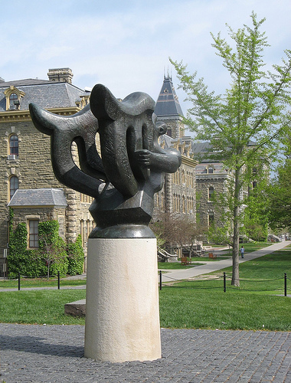
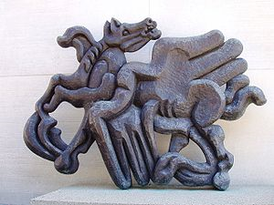
Mixed Media/Sculpture
Jacques Lipchitz
Notes:
(1891-1973)
Of Jewish origin, he was born Chaim Jacob Lipchitz in Druskininkai, Lithuania. He studied engineering before moving to Paris in 1909 to study at the École des Beaux-Arts and the Académie Julian.
It was there, in the artistic communities of Montmartre and Montparnasse that he joined a group of artists that included Juan Gris and Pablo Picasso and where his friend, Amadeo Modigliani, painted "The Sculptor Jacques Lipchitz and His Wife Berthe Lipchitz."
Living in this environment, Lipchitz soon began to create Cubist sculptures. In 1912, he exhibited at the Salon National des Beaux-Arts and the Salon d'Automne with his first one-man show held at Léonce Rosenberg's Galerie L’Effort Moderne in Paris in 1920. In 1922, he was commissioned by the Barnes Foundation in Merion, Pennsylvania for five bas-reliefs.
With artistic innovation at its height, in the 1920s he experimented with abstract forms he called transparent sculptures. Later he developed a more dynamic style, which he applied with telling effect to bronze figure and animal compositions.
With the German occupation of France during World War II, and the deportation of Jews to the Nazi death camps, Jacques Lipchitz had to flee France. With the assistance of the American journalist Varian Fry in Marseille, he escaped the Nazi regime and went to the United States. There, he eventually settled in Hastings-on-Hudson, New York. In 1954 a Lipchitz retrospective traveled from The Museum of Modern Art in New York to the Walker Art Center in Minneapolis and The Cleveland Museum of Art. In 1959, his series of small bronzes "To the Limit of the Possible" was shown at Fine Arts Associates in New York.
Beginning in 1963, he returned to Europe where he worked for several months of each year in Pietrasanta, Italy. In 1972, his autobiography was published on the occasion of an exhibition of his sculpture at The Metropolitan Museum of Art in New York.
Jacques Lipchitz died in Capri, Italy. His body was flown to Jerusalem for burial.

